Slide 1

Efficient Product Segmentation
K-means clustering

Slide 2
Outline
Business and data questions
Data pre-processing
clustering
Business application

Slide 3
Background
business
data
A manufacturing company provides thousands of products within dozens of product categories. There are four central warehouses to ship products it is responsible for. Shipping takes more than one month via ocean to different warehouses.
Efficient product clustering could provide insights on product life-cycle, warehouse management and demand planning.
The data consists of daily historical product demand for a manufacturing company providing 2,160 product types from year 2011 to 2017.
There are 1,048,575 data points of which 11,239 rows have missing dates. These rows are removed from our analysis.

Slide 4
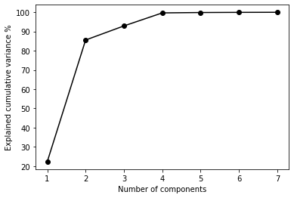
Data preprocessing
K-means without time series
K-means with time series
Aggregate daily demands by year to create 7 sets of yearly demand data for each products.
Using PCA, consider 4 components that explains most of the variance across products.
Data taken from the most recent complete year available i.e. 2016.
Time-series data sets are created each product-types with demand aggregated by month in consideration of the one month period required to ship the supply.

Slide 5
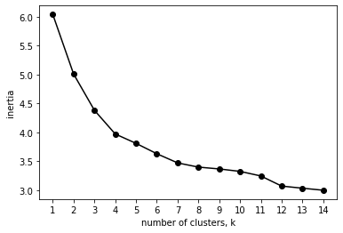
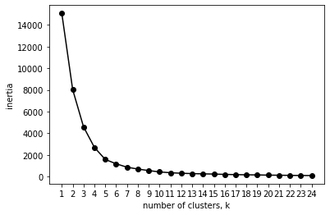
Clustering – Optimal no. of clusters
K-means without time series
K-means with time series

Slide 6
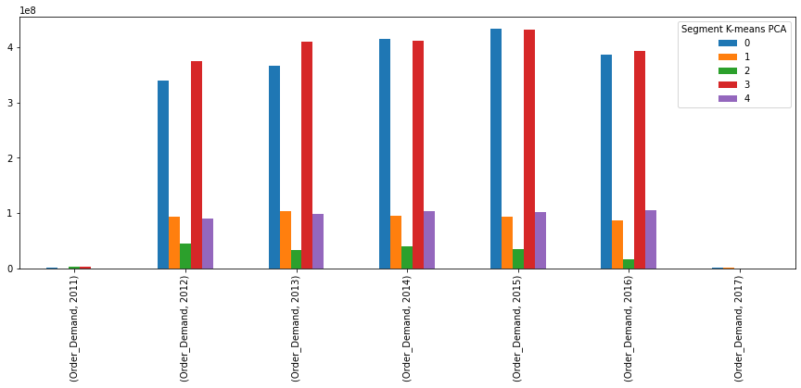

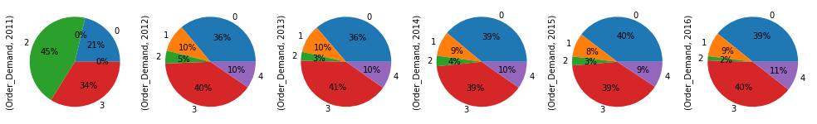
Clustering without time series – Product Life Cycle
Clusters | 0 | 1 | 2 | 3 | 4
No of products | 2128 | 28 | 2 | 1 | 1
98% of the products are similar in terms of yearly demand levels.
However, there are products in clusters 1, 3, and 4 appears to be the top performers in terms of sales volume.
Aside, Cluster 2 seems to be at declining in demand.
Total Order Demand (x100,000,000)

Slide 7
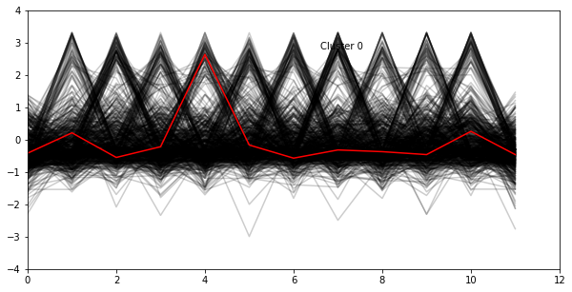
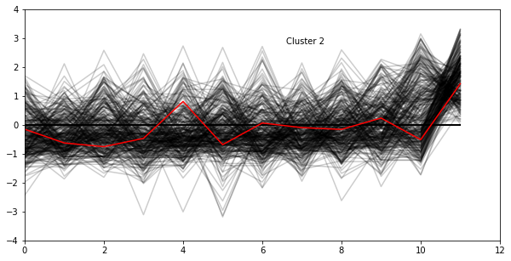
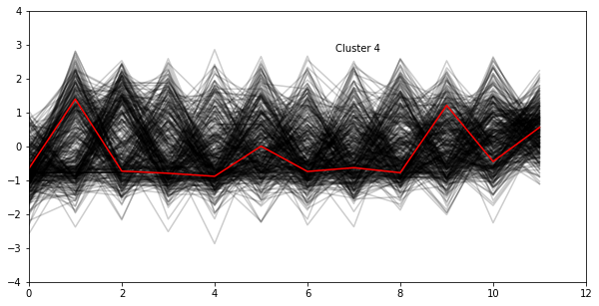
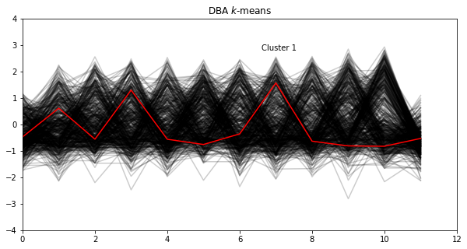
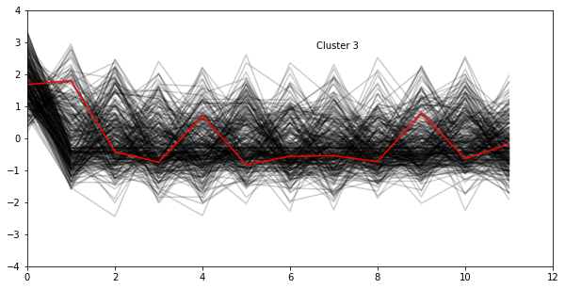
Time series clustering – Demand Planning
Clusters | 0 | 1 | 2 | 3 | 4
No of products | 622 | 525 | 389 | 337 | 287
Clustering enables company to identify different seasonality trends in their products.
Cluster 0 seems to exhibit seasonality with higher demand in April.
Cluster 2 sees peak demand at the end of the year.
Other clusters seems to have higher demand at the start of the year.

Slide 8
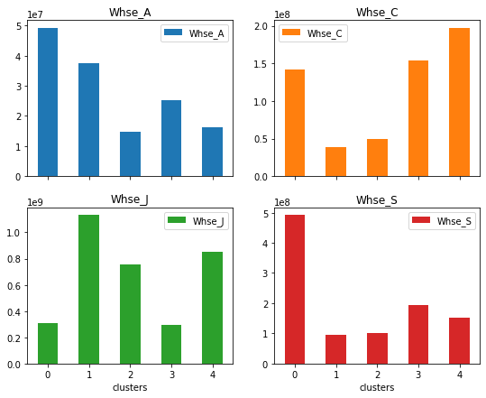
Time series clustering – Warehouse Planning
Each warehouse seems to fulfill higher no of orders from a specific cluster.
Considering different seasonality exhibited by the clusters, business should consider more equal distribution its these clusters of products across its warehouse. This would help to free up space in case on contingencies such as product returns.
However, process specialization may limit the extent to which such change can be made.

Slide 9
Conclusion
While business owners may have sufficient understanding of their products. Clustering can still provide business planners with a data-driven means of reviewing current processes and questioning current understanding.
While more variances can be reduced by increasing no. of clusters, businesses should consider the required resource and effort of the increased complexity.

